Slide 1
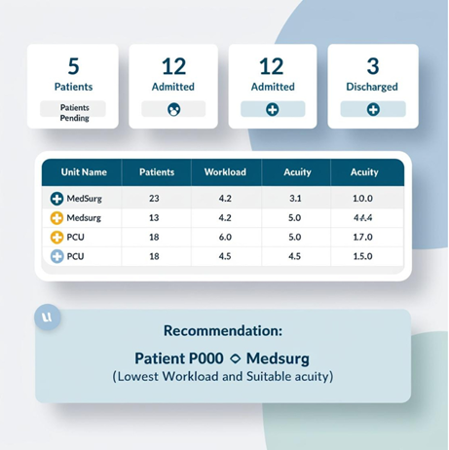

AI-PredictFlow
Optimizing Patient Flow and Resource Allocation
"Using AI to streamline patient flow and resource management in hospitals."
Key Features:
- Predicts patient flow and recommends optimal unit placement.
- Streamlines staff allocation and resource usage.
- Reduces delays and improves patient outcomes.
Team Members
- Salud Lopez
GitHub Repository: https://github.com/ksu-hmi/AI-PredictFlow-Optimizing-Patient-Flow-and-Resource-Allocation/tree/main

Slide 2
Project Overview
Problem
Manual assignment of hospital beds leads to inefficiency.
Staff workload and acuity mismatch increase delays and burnout.
Solution
Use AI to prioritize acuity and workload for optimal patient assignment.
Objective
Improve patient care and patient experience.
Reduce staff burnout.
Optimize hospital resources.

Slide 3
How It Works
1. Patient flagged for admission.
2. Units evaluated based on:
- Acuity (1-10 scale).
- Workload (1-10 scale).
3. Recommendation generated.
4. Final decision by Over house or Bed assigner.
5. Continuous monitoring and updates.

Slide 4

Code Logic
Logic for selecting the best unit:
1. Compare units by acuity (lowest preferred).
2. If acuity is the same, compare workload.
Simplified Example:
IF Unit1.Acuity < Unit2.Acuity THEN
Recommend Unit1
ELSE IF Unit1.Acuity == Unit2.Acuity THEN
Compare Workload

Slide 5
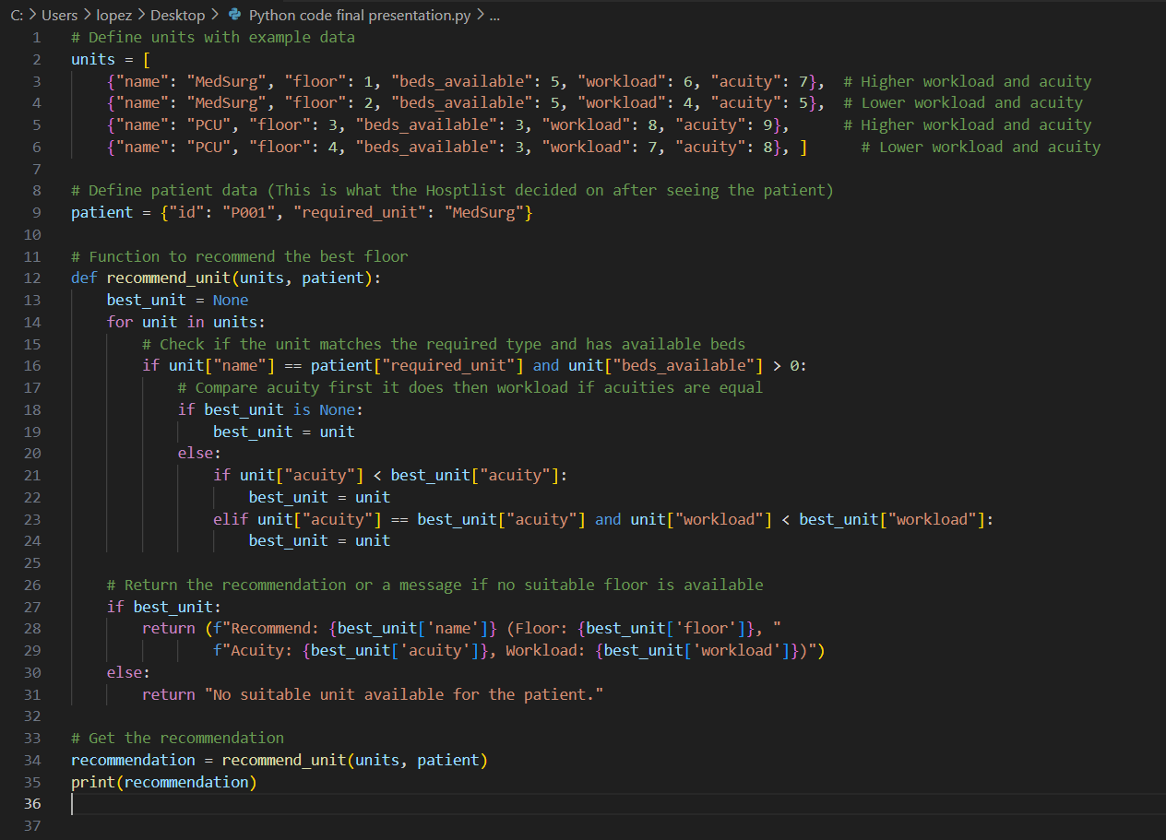
Python Code

Slide 6
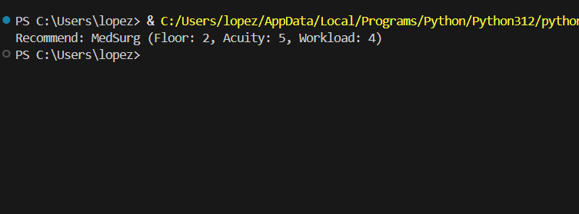
Recommendation Example

Slide 7
Example Scenario
Patient requires MedSurg unit
Available Units:
MedSurg Floor 1
MedSurg Floor 2
MedSurg Floor 1 Acuity 7
Workload 6
MedSurg Floor 2 Acuity 5
Workload 4
Recommendation
MedSurg Floor 2 (Lowest Acuity and Workload)

Slide 8
Challenges and Future Plans
Challenges
1. Would have to be hospital specific.
2. How much time would it take to implement?
Future Ideas
1. Develop real-time updates for the system.
2. Integrate with hospital EHR systems like Epic.
3. Expand functionality to handle specialized units.

